Slide 1
AMAZECARE HOSPITAL MANAGEMENT SYSTEM
NAME : AATHI PRANAVIKA G S
TRAINER NAME: JAVEED MOHAMMED HUSNUDDIN

Slide 2
DESCRIPTION:
AmazeCare is a full-stack healthcare web application that enables patients to book appointments, doctors to manage consultations, and admins to control the overall system. It also allows doctors to maintain medical records, update prescriptions, and track patient history. Patients can view their diagnoses, communicate with doctors, and manage upcoming visits. The platform ensures seamless coordination between patients, doctors, and administrators through a centralized and secure system.
TECH STACK USED
Frontend : Angular
Backend : Java, Spring Boot
Database : MySQL
Authentication : JSON Web Tokens (JWT)

Slide 3
MODULES
User Module
Patient Module
Doctor Module
Appointment Module
Admin Module
Messaging Module (microservice)

Slide 4
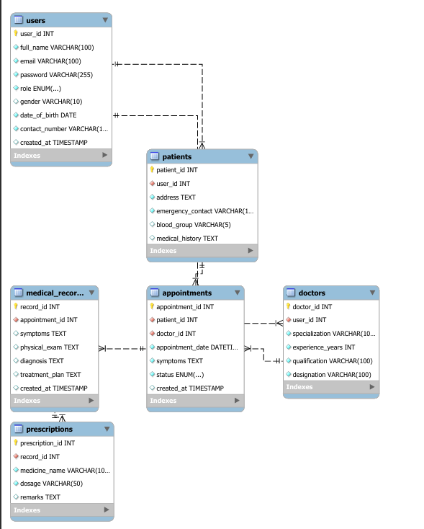
ER DIAGRAM

Slide 5
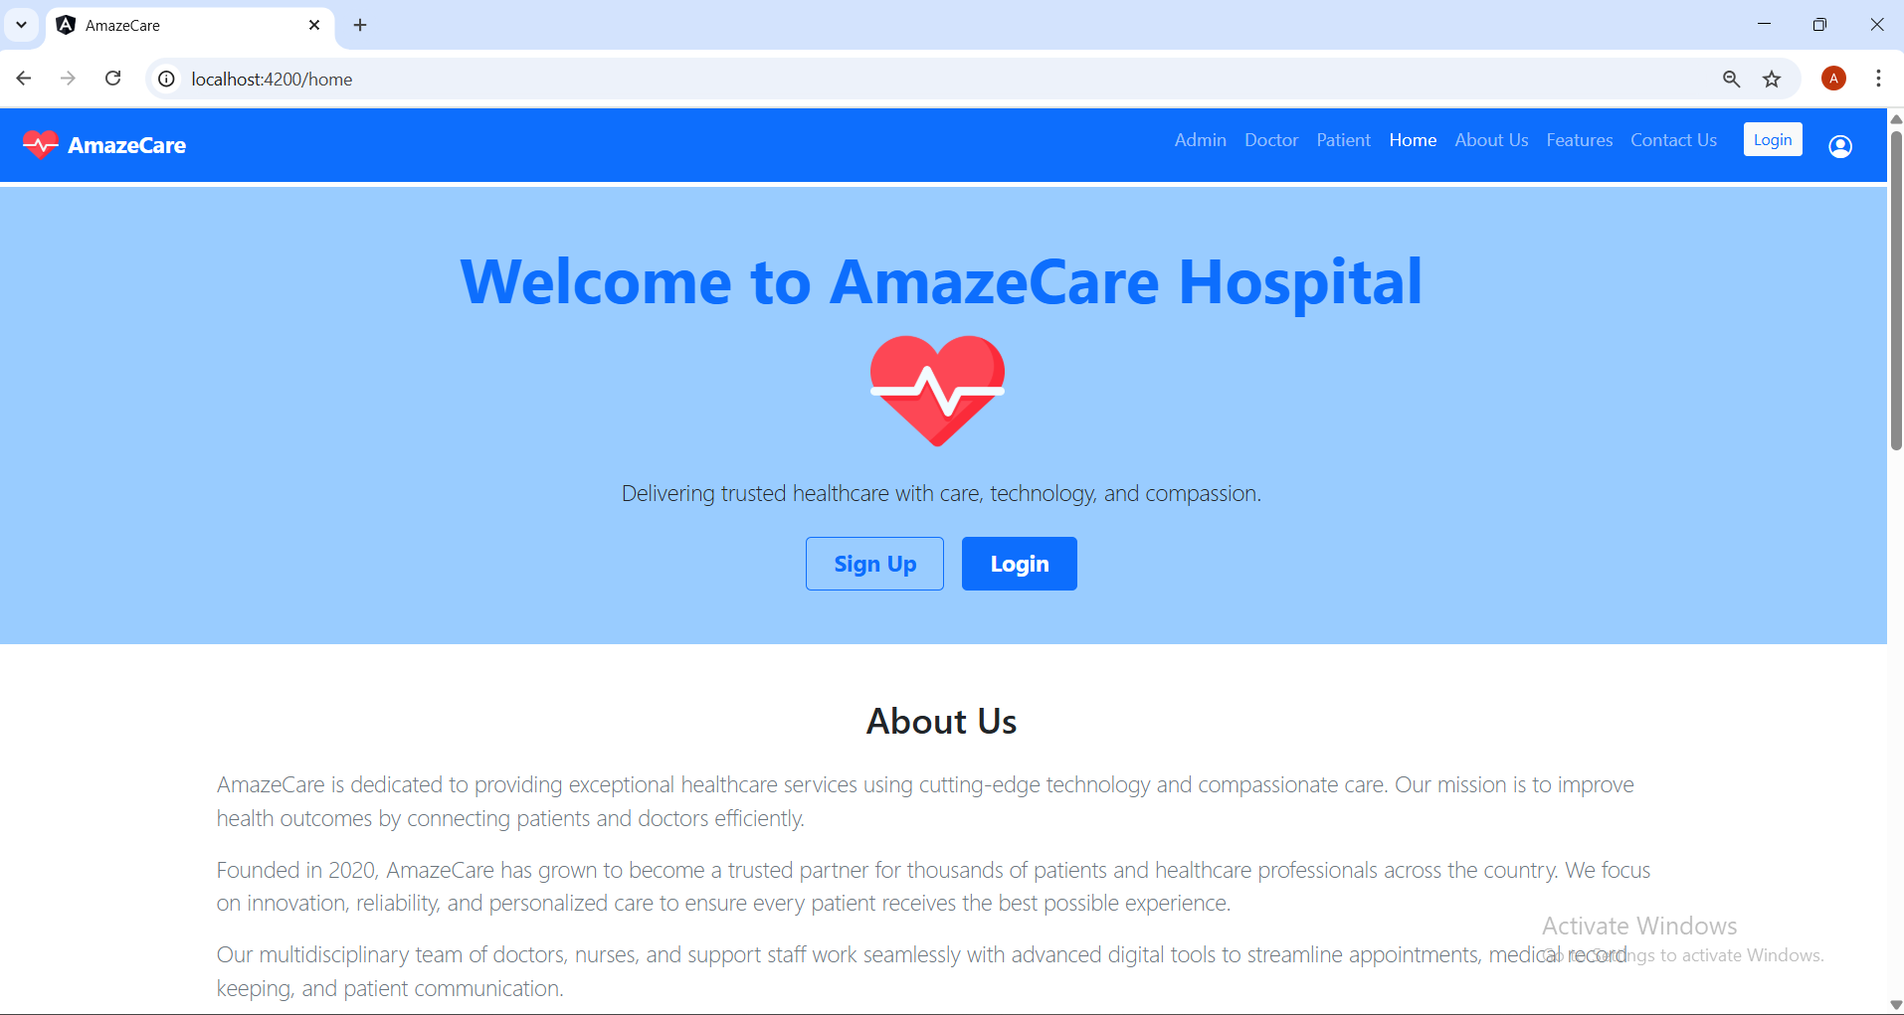

Slide 6
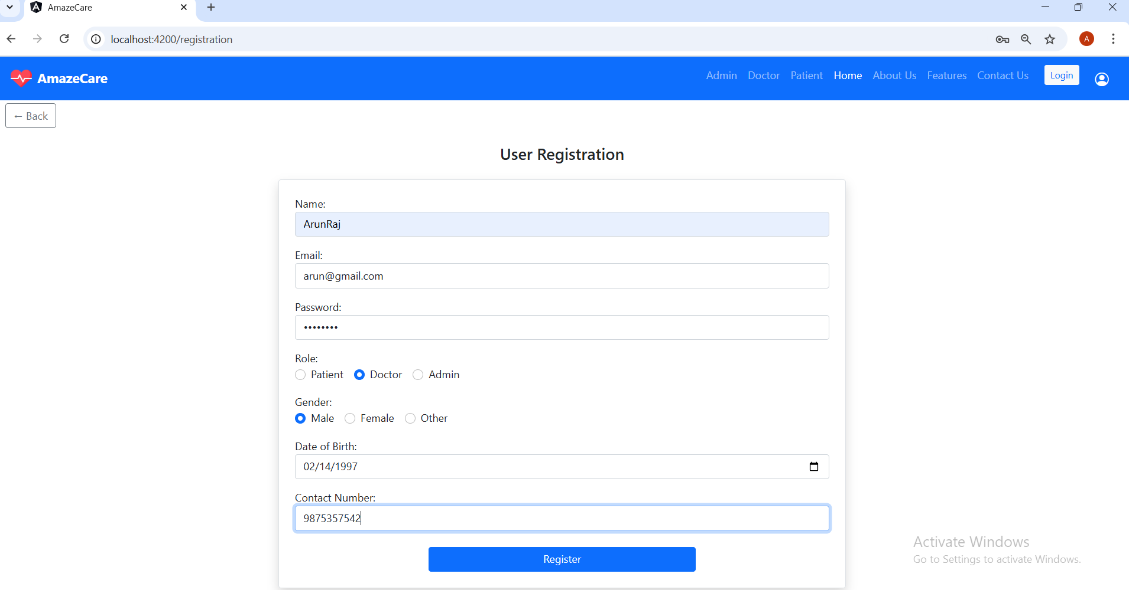

Slide 7
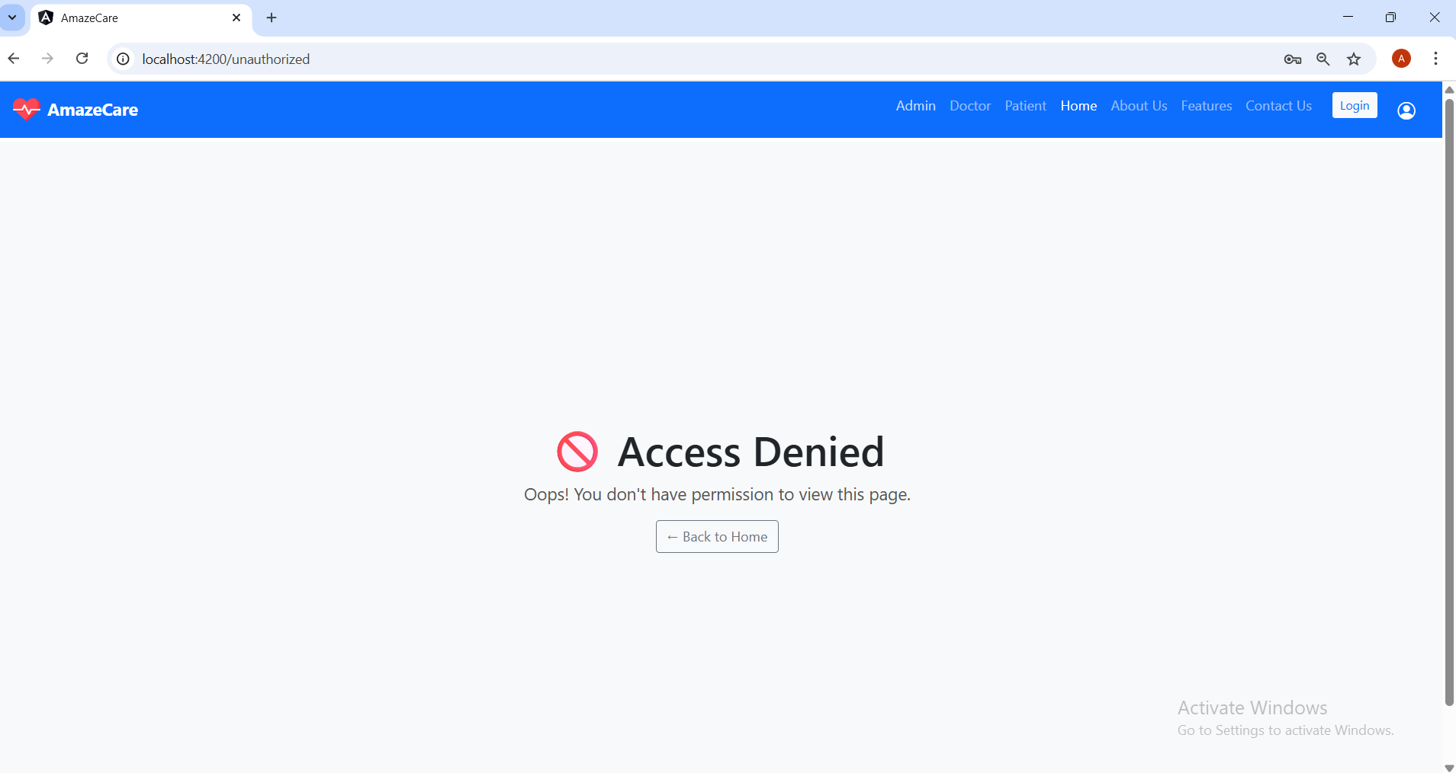

Slide 8
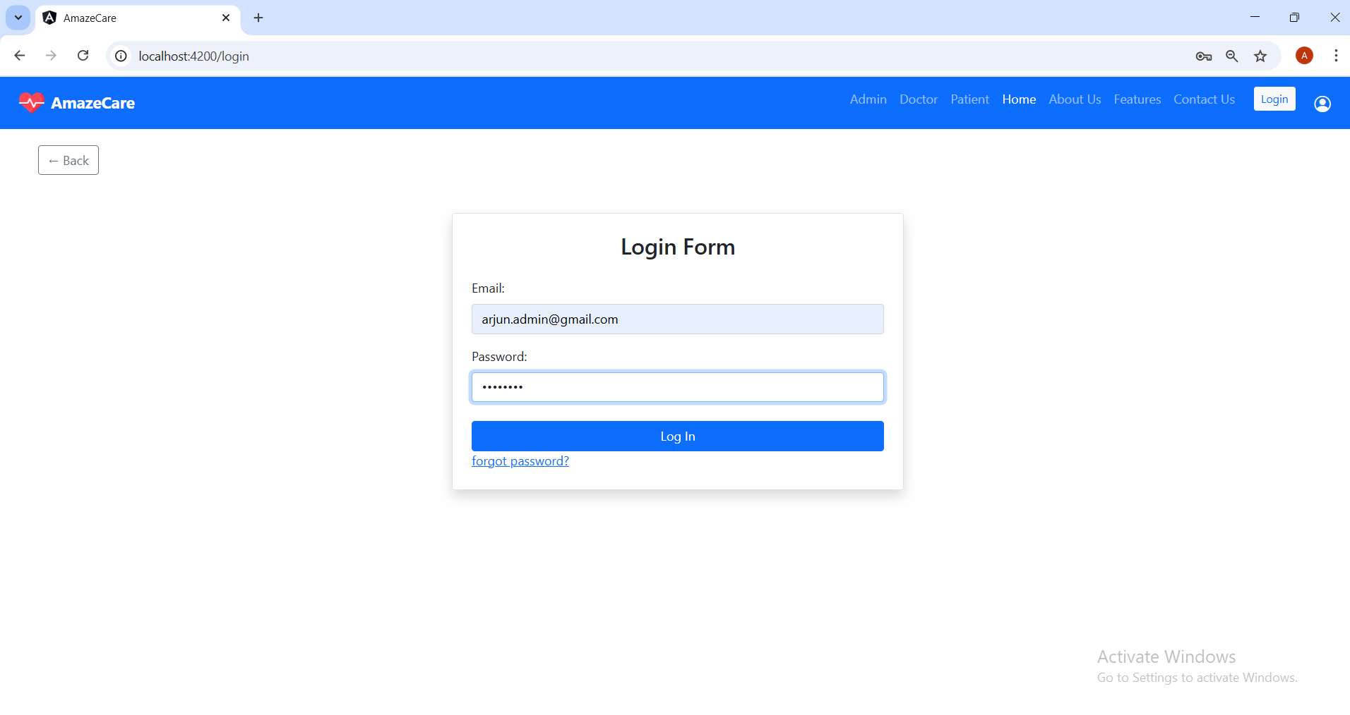

Slide 9
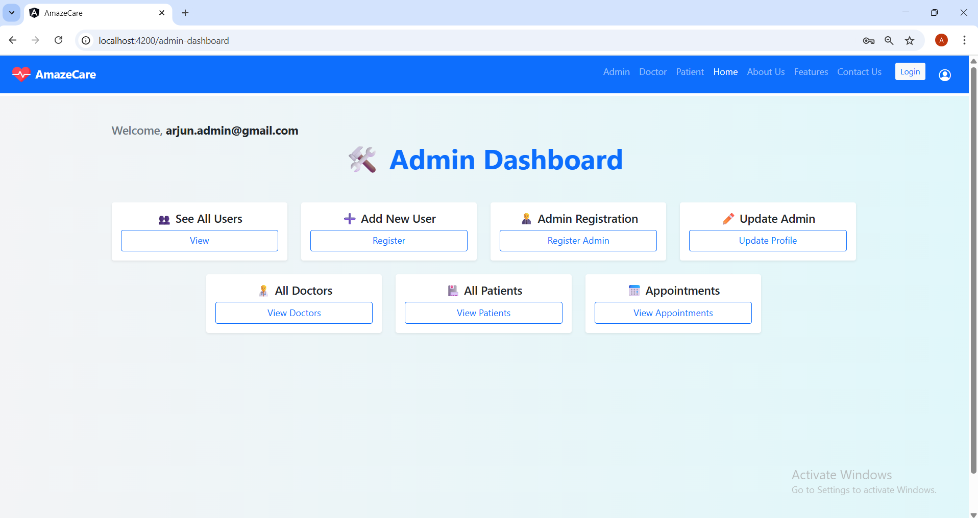

Slide 10
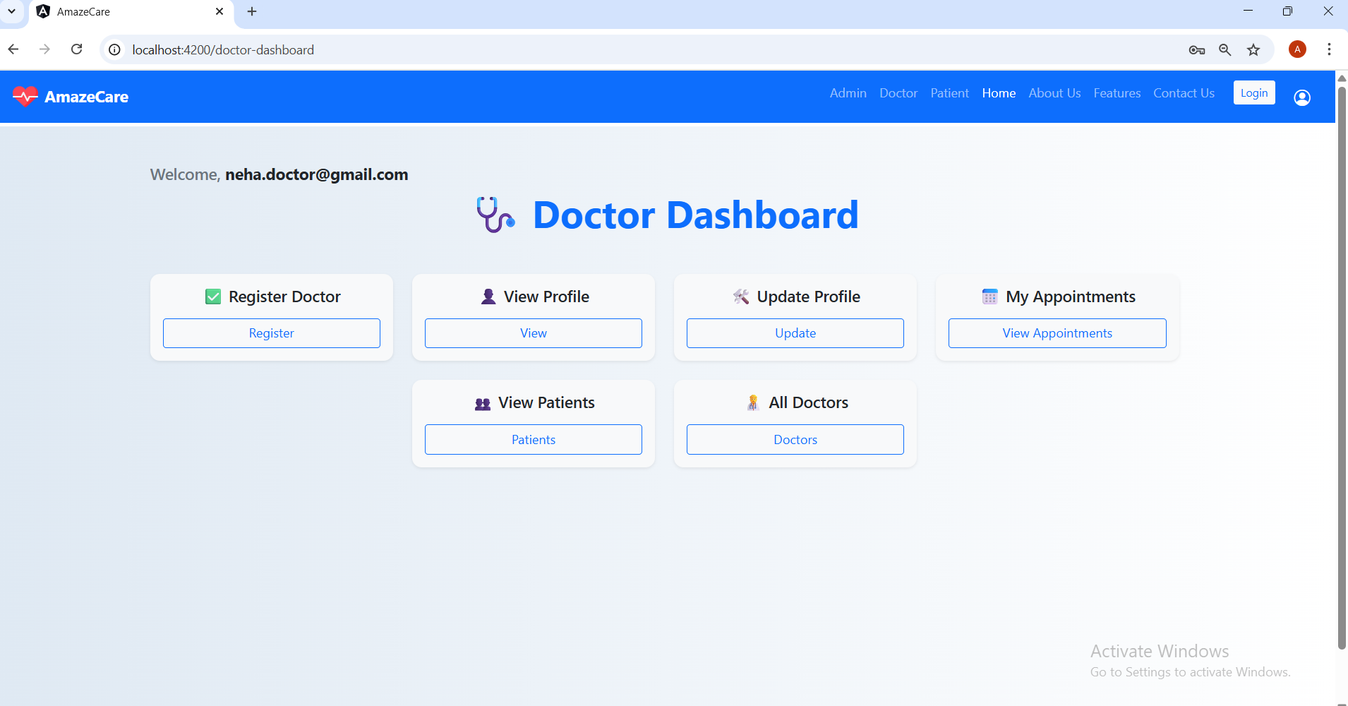

Slide 11
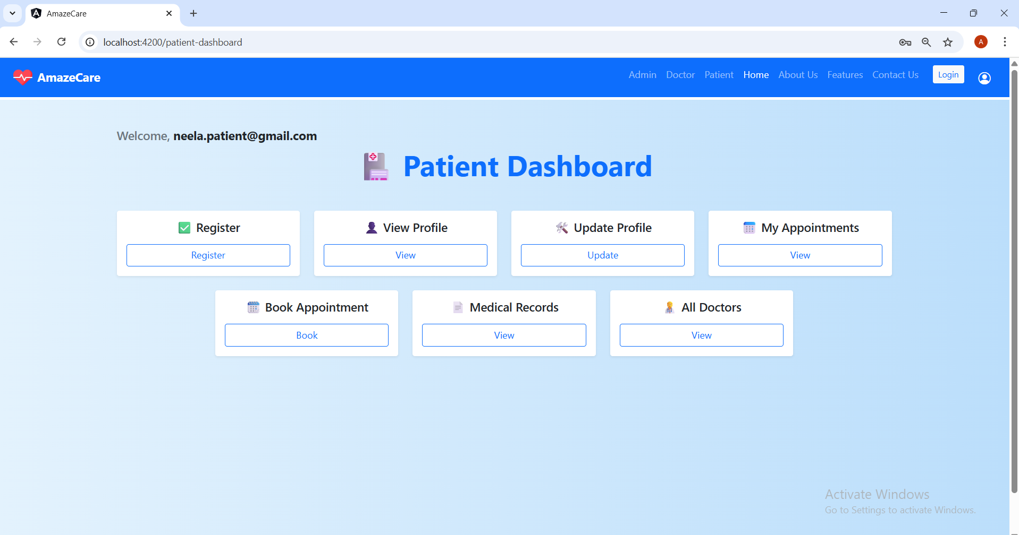

Slide 12
THANK YOU

